Slide 1
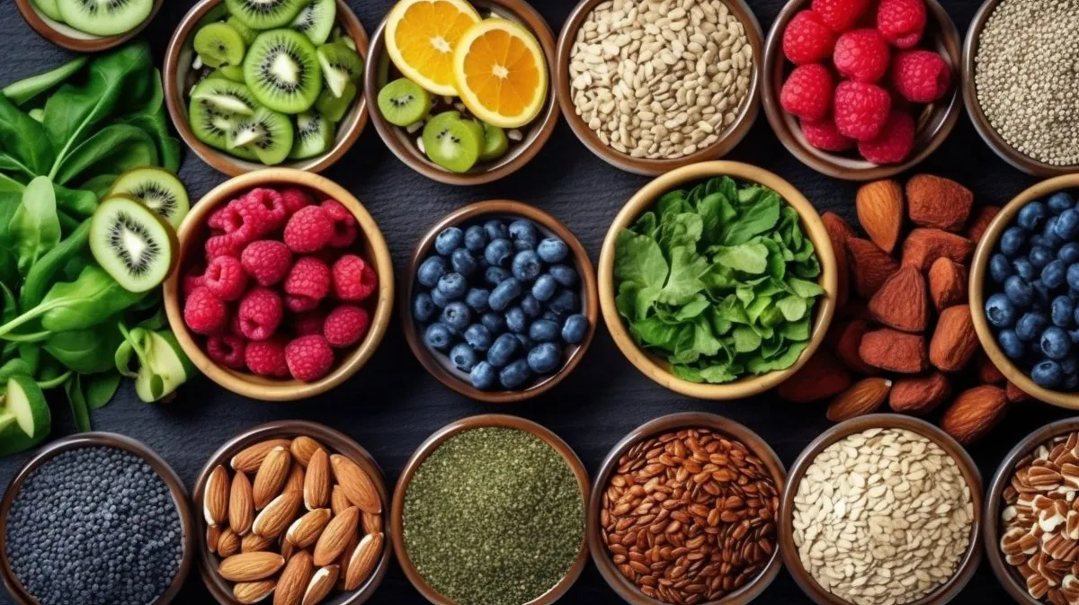

Personalised Nutrition & Wellbeing Through AI
NutriScot
TEAM 6
Mohammed Abdeen
Jen Dargue
Justin Maguire
Iraklis Pissaris
Euan Smith
Eat a healthy
balanced diet

Slide 2
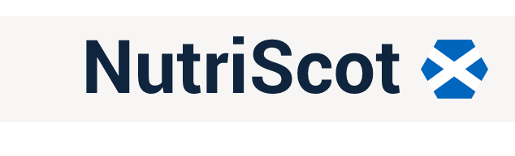
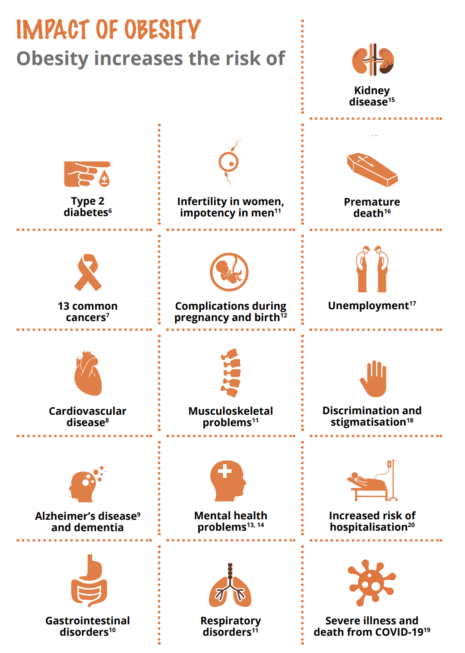
Nutrition in Scotland
Of all health years lost in Scotland, one in five are attributable to excess weight or poor diet (Scottish Burden of Disease)
Improvement of diet could potentially prevent one in every five deaths globally (Berry et.al 2020)*
According to the Scottish Government's Diet and Healthy Weight: Monitoring Support (2020), obesity costs the Scottish NHS up to £600 Million annually.

Slide 3
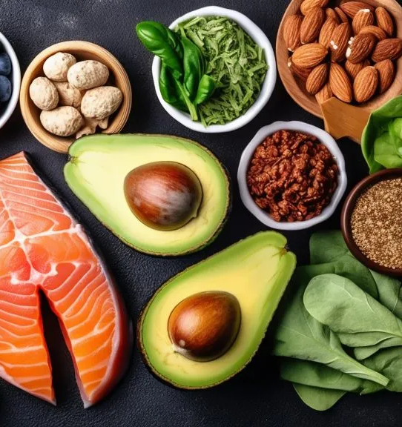
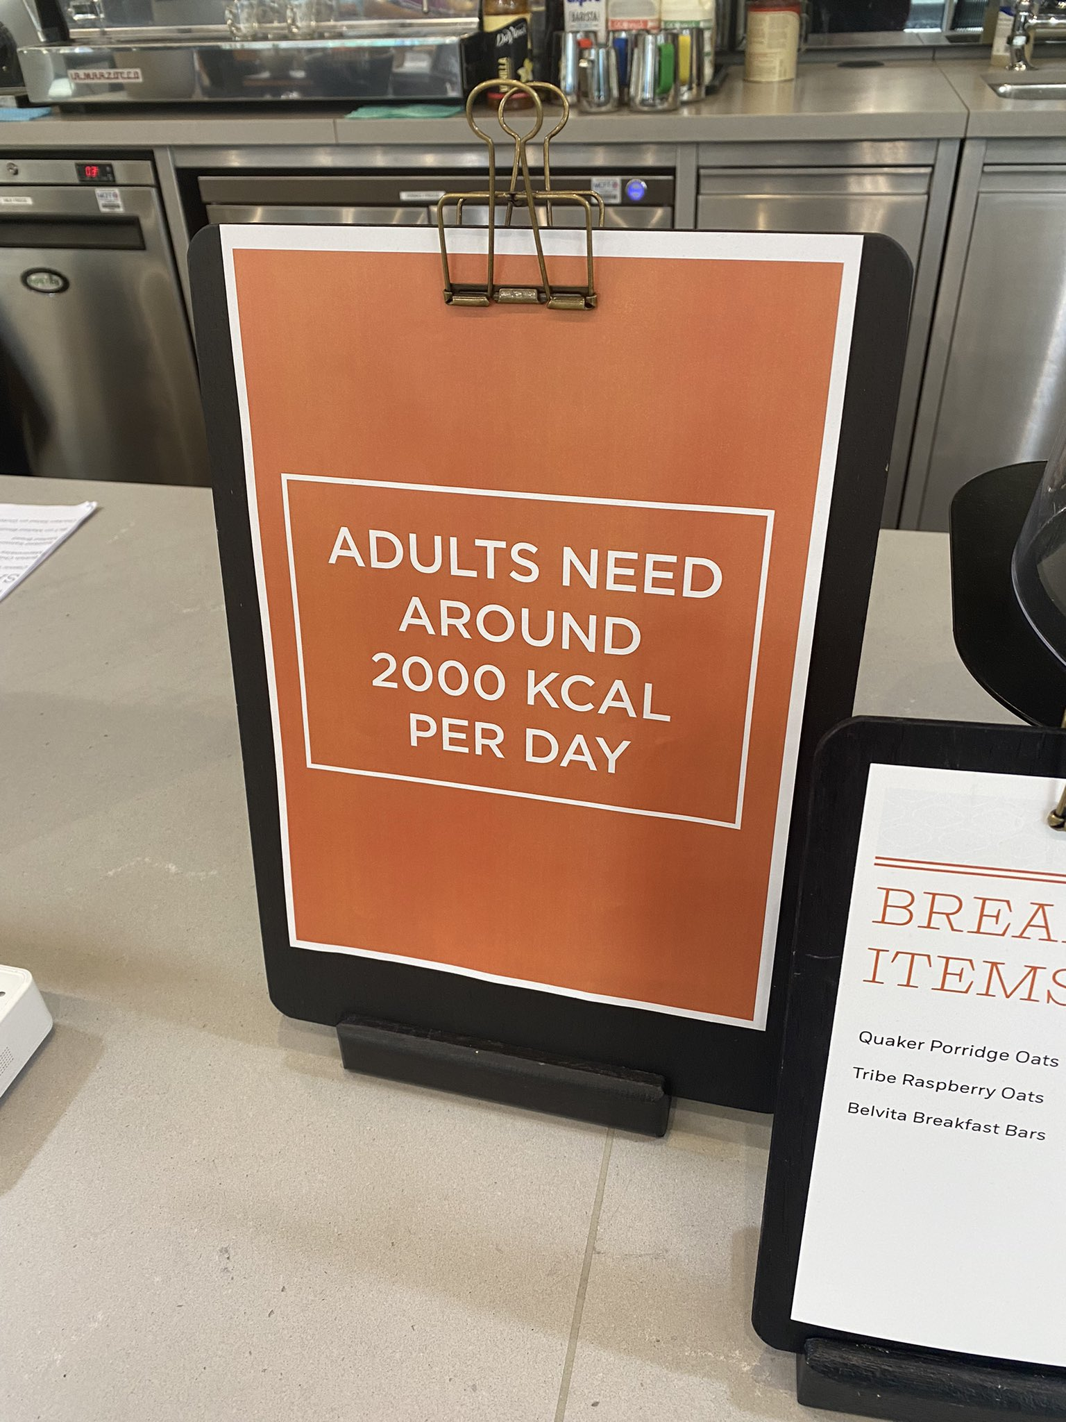
Nutrition in Scotland
Everyone has different dietary needs, and this is not reflected in current guidelines, even the more comprehensive ones like the NHS' 'Eatwell Guide'.
It is often seen in the likes of restaurants and shops that 'adults require around 2000 calories a day. This is extremely subjective.

Slide 4
Scottish Health Policy
People have access to effective weight management services
Children get the best start in life - they eat well and have a healthy weight
Diet & Healthy Weight
Diet-related health inequalities are reduced
The food environment supports healthier choices
Leaders across all sectors promote healthy weight and diet
Presentation Title

Slide 5
Scottish Health Policy
People have access to effective weight management services
Children get the best start in life - they eat well and have a healthy weight
Diet & Healthy Weight
Diet-related health inequalities are reduced
The food environment supports healthier choices
Compliment this vision and deliver access to weight management services
Utilise biomonitoring and AI to deliver personalised nutrition and support
Leaders across all sectors promote healthy weight and diet
Presentation Title

Slide 6
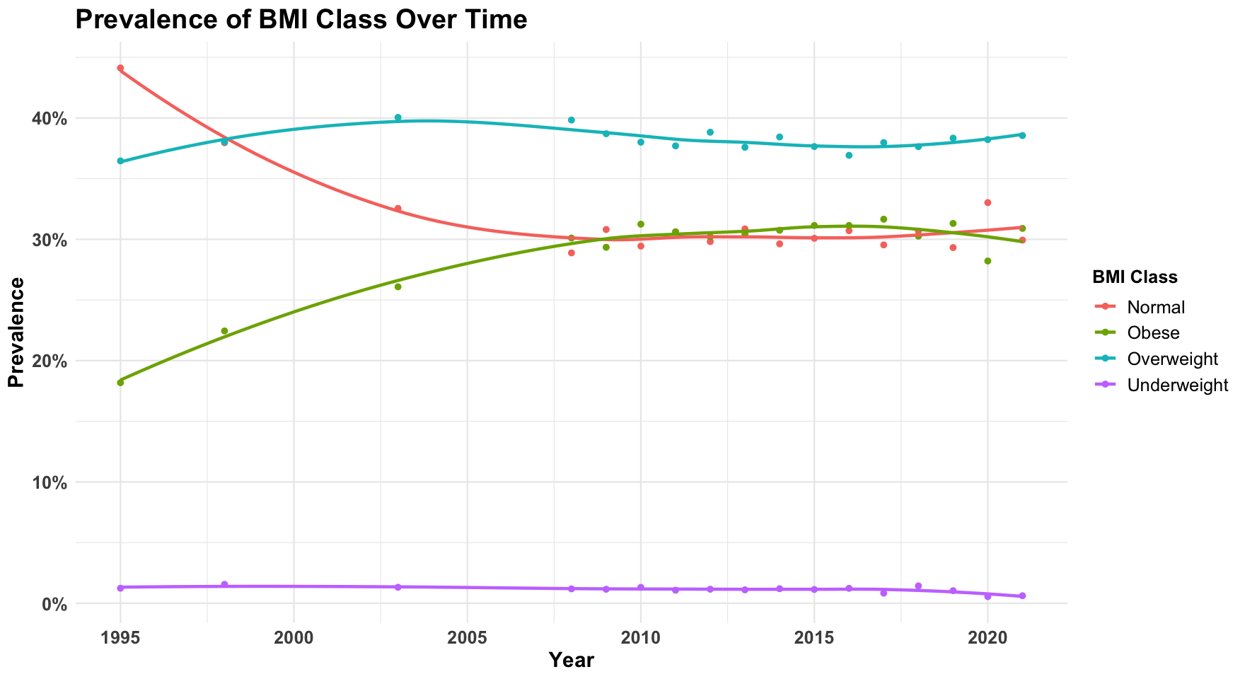
Obesity
In Scotland
Since 1995, data from the Scottish Health Survey shows a significant narrowing of the gap between individuals of normal weight and those who are obese.
This trend may lead to a further increase in negative health outcomes.
Presentation Title

Slide 7
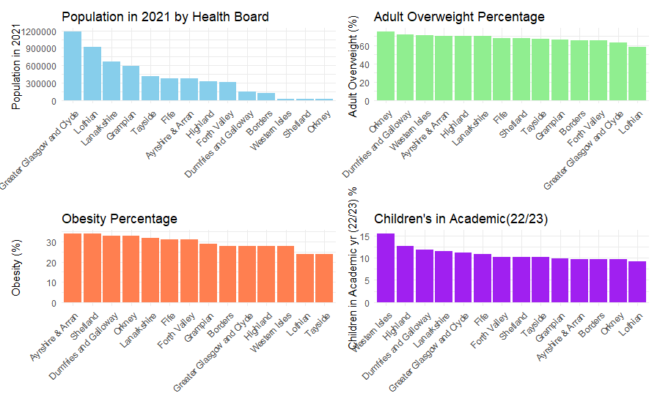
Obesity
In Scotland
Being overweight has become a normal condition, and Britain is now becoming an obese society.
Around two-thirds of all adults in Scotland (67%) are living with overweight (including obesity), with one third (33%) of children starting primary school being at risk of overweight (including obesity).
Presentation Title

Slide 8
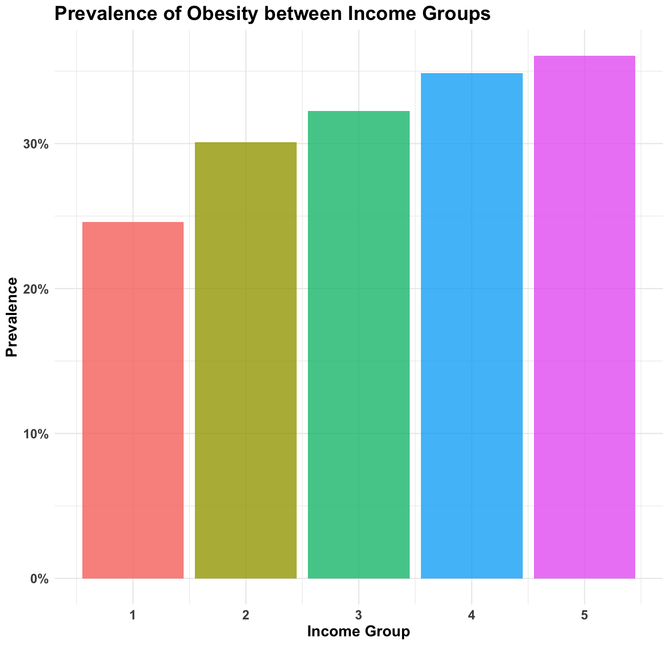
Obesity
In Scotland
Obesity rates are higher in areas of greater deprivation, particularly among women, children, older age groups, black and minority ethnic groups, and people with disabilities.
Presentation Title

Slide 9
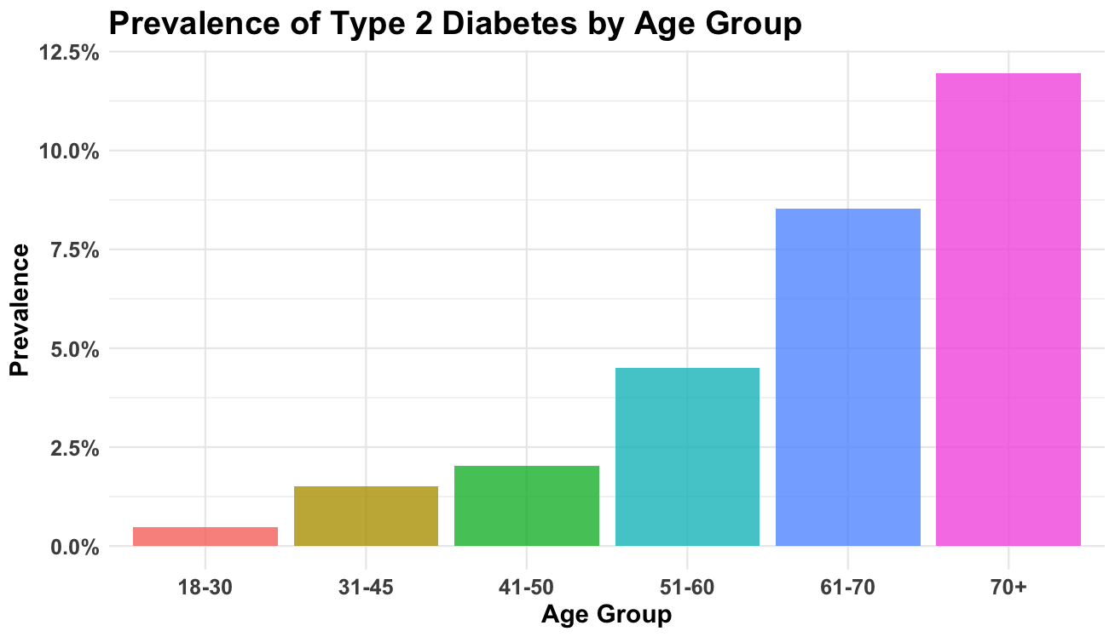
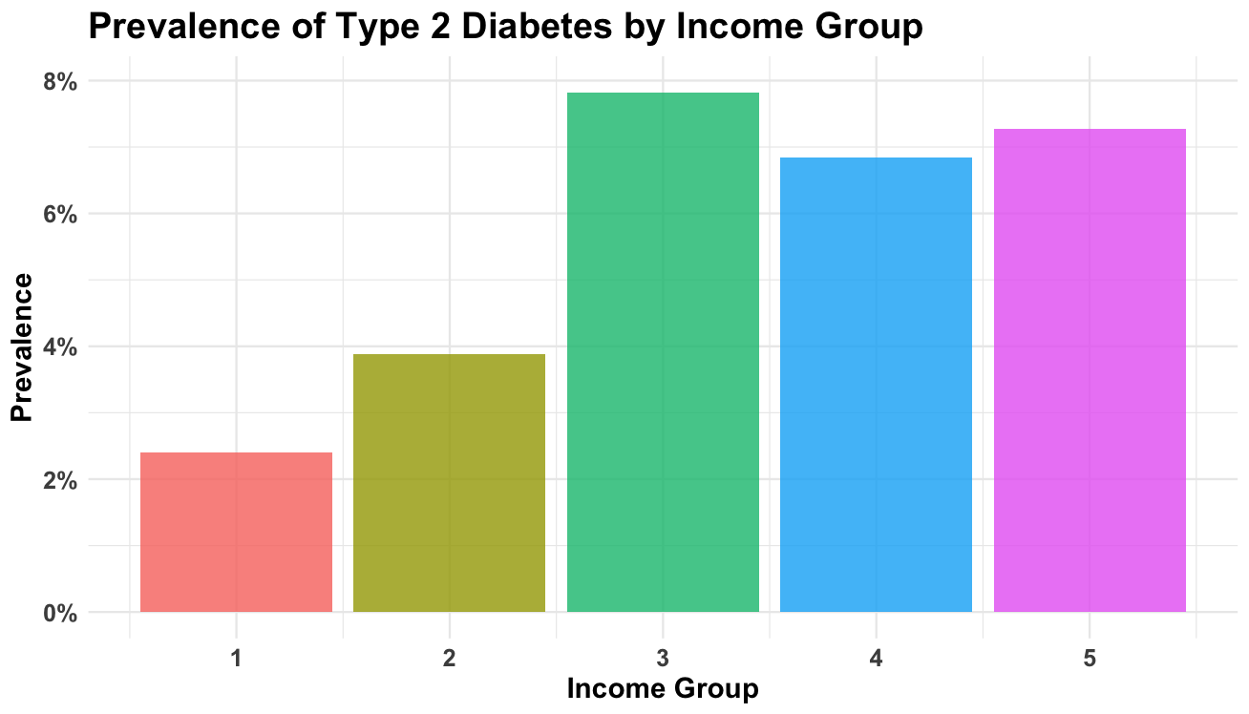
Type 2 Diabetes in Scotland
Obesity is a significant contributor to the onset of Type 2 diabetes due to its impact on insulin resistance. Studies show that people who are obese are up to 80 times more likely to develop Type 2 diabetes than those within a healthy weight range.
The Scottish Public Health Observatory estimates that almost half of Type 2 diabetes can be attributed to obesity.
Factors influencing prevalence of type 2 diabetes are diets high in sugar and processed foods which leads to blood sugar spikes.
Presentation Title

Slide 10
NutriScot
Priority Users
Users at risk of adverse health conditions due to weight
Referred by GPs/Health Professionals
Potential to create tiers for future roll out to different user groups
Deliver personalised nutrition and wellbeing to improve public health in Scotland through biomonitoring and AI

Slide 11
NutriScot
Priority Users
Users at risk of adverse health conditions due to weight
Referred by GPs/Health Professionals
Potential to create tiers for future roll out to different user groups
Biomonitoring
Smartwatch - heartrate, sleep and activity
Smartscale - weight and body composition
Continuous glucose monitor
Blood and stool samples – to establish personalised dietary requirements
Deliver personalised nutrition and wellbeing to improve public health in Scotland through biomonitoring and AI

Slide 12
NutriScot
Priority Users
Users at risk of adverse health conditions due to weight
Referred by GPs/Health Professionals
Potential to create tiers for future roll out to different user groups
Biomonitoring
Smartwatch - heartrate, sleep and activity
Smartscale - weight and body composition
Continuous glucose monitor
Blood and stool samples – to establish personalised dietary requirements
Machine Learning
Results of user biomonitoring used to predict the optimum nutrition for health
Algorithms continually evaluate how food and lifestyle effect the user
Supportive AI feedback available to user via video, audio or written formats
Deliver personalised nutrition and wellbeing to improve public health in Scotland through biomonitoring and AI

Slide 13
NutriScot
Priority Users
Users at risk of adverse health conditions due to weight
Referred by GPs/Health Professionals
Potential to create tiers for future roll out to different user groups
Biomonitoring
Smartwatch - heartrate, sleep and activity
Smartscale - weight and body composition
Continuous glucose monitor
Blood and stool samples – to establish personalised dietary requirements
Machine Learning
Results of user biomonitoring used to predict the optimum nutrition for health
Algorithms continually evaluate how food and lifestyle effect the user
Supportive AI feedback available to user via video, audio or written formats
Deliver personalised nutrition and wellbeing to improve public health in Scotland through biomonitoring and AI
Dietary Assistance
Improve ease of eating well
AI generates bespoke meal plans and recipes based on nutritional needs and user preferences
User refines meal choices and API sends shopping list to users choice of partner supermarket
Connected to partnered supermarkets, auto-fill e-commerce basket for click and collect, or delivery

Slide 14
NutriScot
Priority Users
Users at risk of adverse health conditions due to weight
Referred by GPs/Health Professionals
Potential to create tiers for future roll out to different user groups
Biomonitoring
Smartwatch - heartrate, sleep and activity
Smartscale - weight and body composition
Continuous glucose monitor
Blood and stool samples – to establish personalised dietary requirements
Improving Health in Scotland
Supports NHS Dieticians, enabling them to help more patients
Reducing the burden of disease to NHS caused by obesity, in particular type 2 diabetes and cardiovascular disease
Use platform to provide nutritional education
Potential to roll out to additional user groups
Machine Learning
Results of user biomonitoring used to predict the optimum nutrition for health
Algorithms continually evaluate how food and lifestyle effect the user
Supportive AI feedback available to user via video, audio or written formats
Deliver personalised nutrition and wellbeing to improve public health in Scotland through biomonitoring and AI
Dietary Assistance
Improve ease of eating well
AI generates bespoke meal plans and recipes based on nutritional needs and user preferences
User refines meal choices and API sends shopping list to users choice of partner supermarket
Connected to partnered supermarkets, auto-fill e-commerce basket for click and collect, or delivery

Slide 15
Stakeholders
Stakeholder | Needs | Interest | Influence
NHS Scotland | Reduce obesity-related health issues and costs | Improved patient health, reduced strain on healthcare services | High; responsible for healthcare delivery and integration
Government (Health Department) | Population-wide health improvements and reduced healthcare expenditure | Achieving national health targets, budget optimization | High; policy-making, funding approval, strategic oversight
Patients | Personalized, manageable, affordable nutrition guidance | Better health, reduced medical visits, access to trusted health resources | High; their participation and feedback are crucial
Project Team | Clear direction, resources, and ongoing support from stakeholders | Achieving project goals, demonstrating impact, creating a scalable health improvement model | High; execution of the project, stakeholder collaboration
Tech Contractors | Accurate data and feedback for optimizing AI algorithms | Success of the AI solution, innovation potential, expanded application in health projects | Medium to High; they provide technical backbone and AI efficacy
Notes:
Go over general idea

Slide 16
Project Team
TEAM 6 Ltd.
Mohammed Abdeen Jen Dargue Justin Maguire Iraklis Pissaris Euan Smith
Ideation, Marketing, Project Management, Stakeholder Liaison
Stakeholders
SaaS Development Specialists
Specialist AI/ML Consultancy
Clinical Laboratory

Slide 17
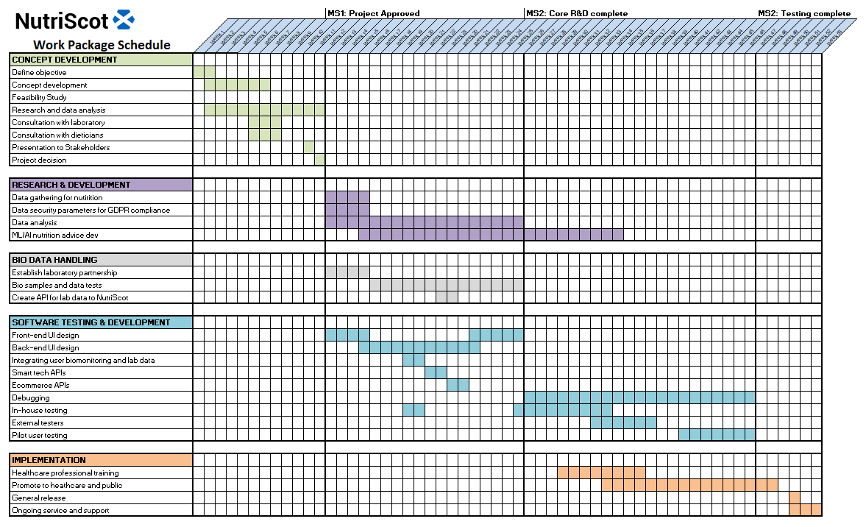

Slide 18

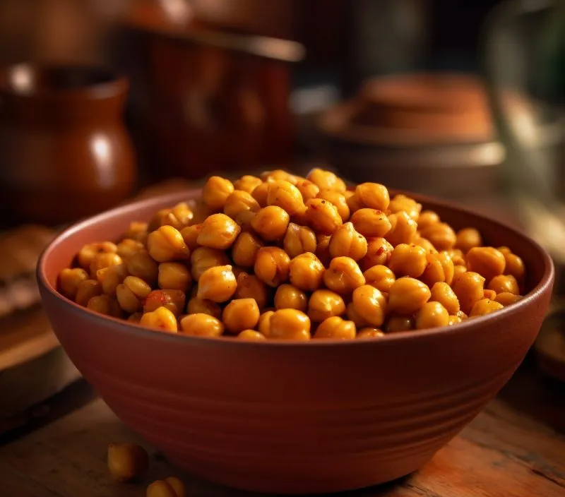
Thank you
TEAM 6 Ltd.
Mohammed Abdeen
Jen Dargue
Justin Maguire
Iraklis Pissaris
Euan Smith

